Slide 1


Domain Knowledge​ Guideline Bot
By Group 7
Project Development & Design Management
CapitaLand Development
(PDDM, CLD​)

Slide 2

TABLE OF CONTENTS
01
02
03
Problem Statement
Solution Architecture
Impact & Experience

Slide 3



PROBLEM STATEMENT
PDDM projects can require significant time searching and comparing domain knowledge with the market
Knowledge has to be updated continuously to remain current and at the leading edge.

Slide 4

INTRODUCING... AI!
Many of these grunt work can be streamlined by AI
Reduces manual efforts without sacrificing accuracy
Align with industry best practices and accelerates time-to-market

Slide 5
Knowledge Base Retrieval Assistant

Slide 6




HOW IT WORKS
Coordinator (Parent) Agent
Search Business Knowledge Base
Research Online for Data
Local Files (Child) Agent
Web Search (Child) Agent

Slide 7
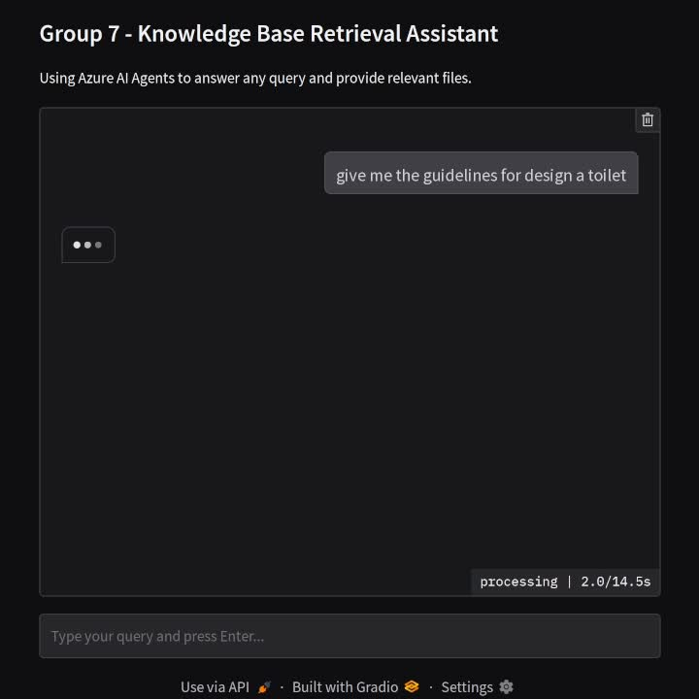
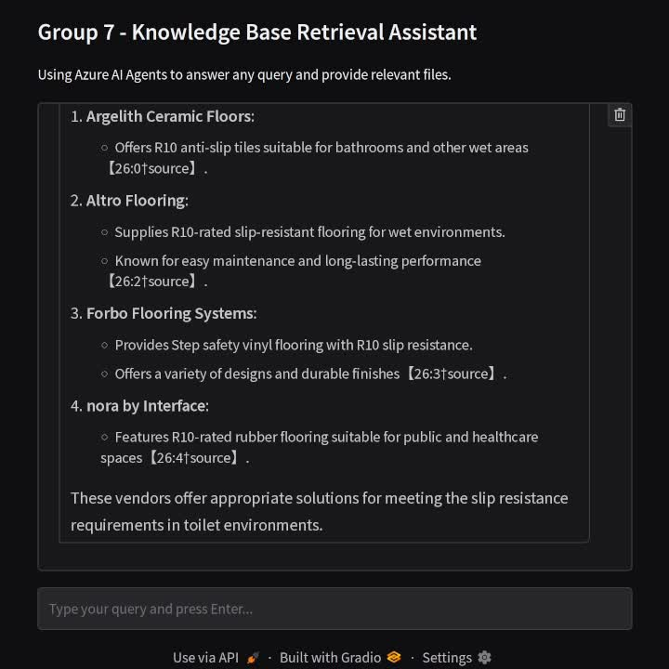
DEMO
Searching for Guideline-compliant Toilet Floors
Retrieving different editions of the same form

Slide 8





TECHNOLOGY STACK
Frontend
Backend
Gradio
For rapid prototyping
Azure AI Foundry
Bing Search
For searching online sources
GPT 4o
One of the most stable LLM models in the market
Azure AI Search/ Multimodal RAG
Enable handling of multiple file types

Slide 9





SOLUTION BENEFITS
Maintaining standards
Extract Relevant Domain Knowledge
Analyse
Market Norms/Trends
Provide insights for innovation
Suggest improvements in Domain Knowledge Base

Slide 10


BENEFITS
Search Time Saving
Efficient and Quality Market Research
Less time searching between folders for specific files
Fast, accurate retrieval of information from multiple sources
Allocation of time to other aspects of the project (e.g. collaborative work)
Less time searching relevant online sources
Automatically gather insights from diverse sources
Quickly compare the latest guidelines and competitor strategies with the domain knowledge

Slide 11


BUSINESS VALUE
Boosts Growth
Staying Ahead in the Market
Handle more initiatives simultaneously without compromising quality
Quickly validate new ideas against market viability threshold to develop tailored products
Minimize manual processes to optimize resource allocation
Accelerating time-to-market streamlining research and development (R&D)
Quickly adapt and respond to market shifts to the latest trends and emerging technology
Turn latest data into actionable strategies to launch cutting-edge and innovative products / services.

Slide 12
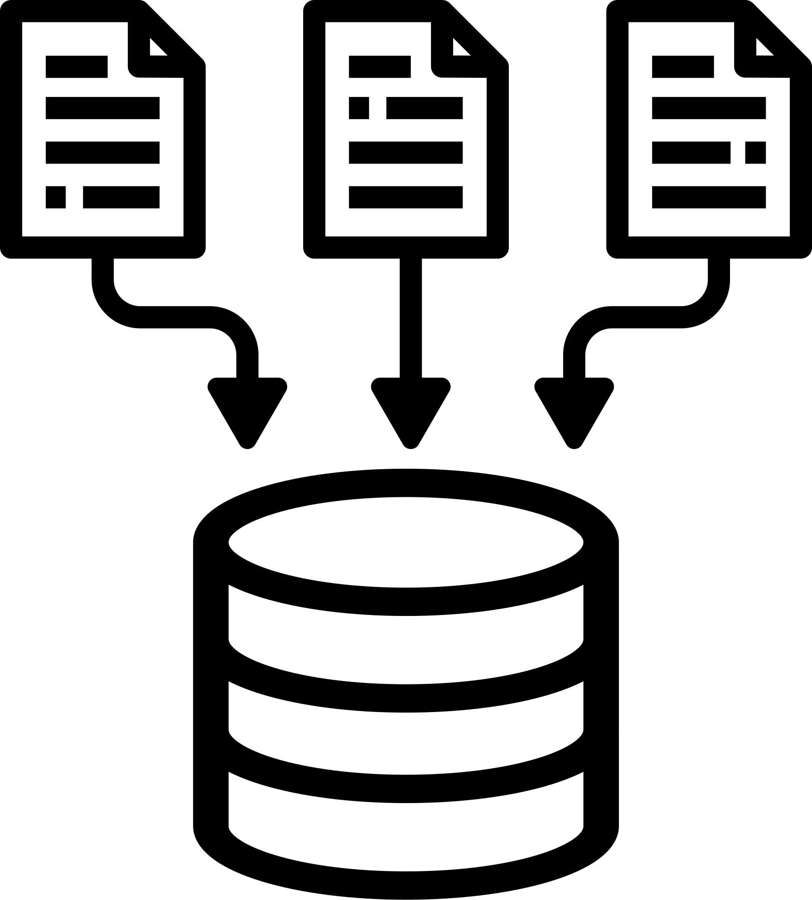
SCALABILITY
Solution Modularity
Knowledge Backbone
One connection failure does not render entire solution broken down
Can continuously develop and upgrade agents for different roles
Agents can be triggered in parallel, reducing response times
New guidelines, formats, regulatory standards can be added seamlessly
Serves cross-functional units without needing separate databases
Can be expanded to larger database with multi file type compatability

Slide 13

THANK YOU!

